Slide 1

Virtual gaming
Executive summary

Slide 2
Product
Our product is offered in the field of entertainment and technology. Our main product is a combination of a virtual reality game and a Kinect, which allows the player to experience three-dimensional simulation of a game environment using a Virtual Reality (VR) gear. The Kinect is used as a motion sensing device that enables the player to control and interact in the simulation provided in the gear without using handheld game controllers.

Slide 3
Product (CONT’D)
Our product aims to provide more immersive and interactive game experience to end-users, both gamers and non-gamers alike.

Slide 4
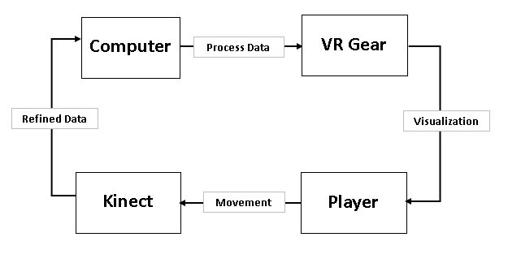
Block Diagram

Slide 5
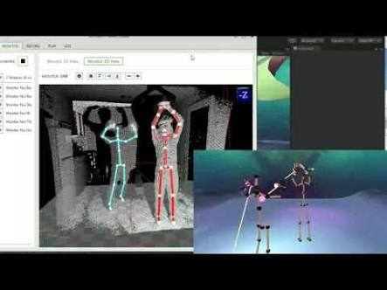
Expected output

Slide 6
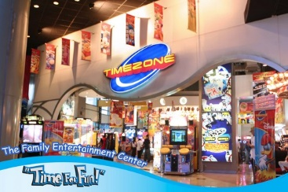

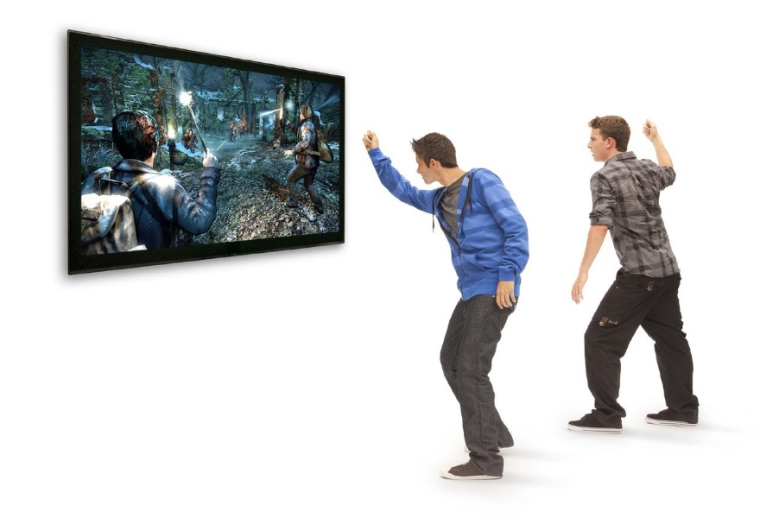
MARKET SIZE
Our aim is to sell our product to game-developing companies, arcade shops, business companies that provides entertainment just like in malls and amusement park, and for private individual to be used on their own homes for entertainment.

Slide 7
Marketing Strategy
Build strong brand positioning through websites, social media and other channels.

Slide 8
Competitive Advantage
Our product’s main advantages are its cost, availability and its going fame. We used a Gear VR as an alternative for an Oculus Rift, the cost of the product becomes lesser. Also, we use a Kinect sensor to detect full body motion as a controller compared to other companies that uses handheld motion controllers that made our product price lesser. The availability of the materials used by other companies are limited in market, making our product a high-priority choice among the other companies.

Slide 9
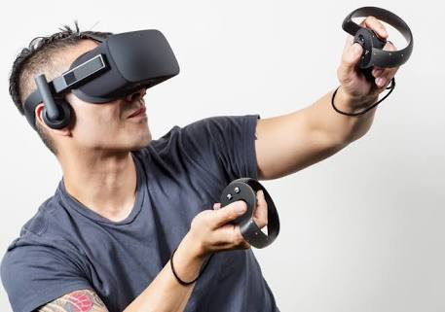
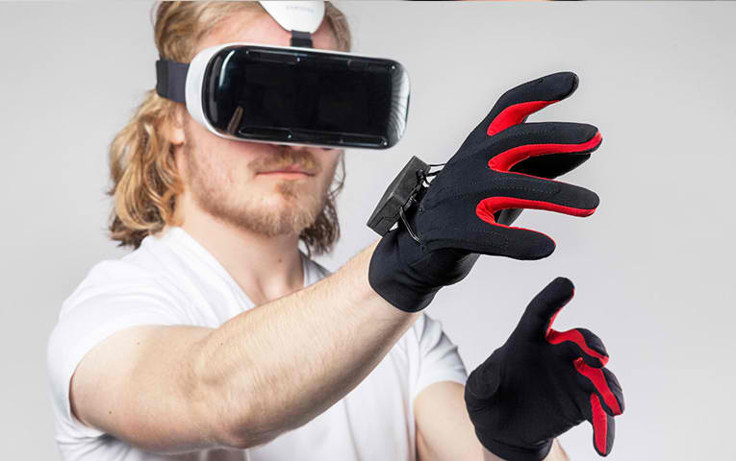
Motion controller used by other companies
The Oculus Touch
Manus VR Gloves

Slide 10

Cost
Since the developer tool for Kinect is free of charge, The cost of our product will solely depend on the price of the device. The cost of the games, however, will depend on the developers. Independent developer will most likely release their games for free, while other companies will surely sell their games for a reasonable cost.

Slide 11

Payoff
Profit gained from selling the product and through advertisements.

Slide 12

Management Team
Kyle Nomar C. Diores
-Age: 20
-Civil Status: Single
-Position: Software Manager

Slide 13

Management Team
Christian Mae D. Lebumfacil
Civil Status: Single
Age:21
Position: Hardware manager

Slide 14

Management Team
Efren Caballes
Age: 21
Civil Status: Single
Position: Marketing and Sales Manager

